Slide 1

MACHINE LEARNING ACCELERATOR
Natural Language Processing – Lecture 1
Notes:
Welcome to Machine Learning Accelerator – the TABular Data course
Day 3

Slide 2
Learning Outcomes
Fundamental understanding of data preprocessing, commonly used machine learning (ML) algorithms, and model evaluation
Practical knowledge of natural language processing (NLP) specific model training and applications
Be comfortable talking with scientist partners
Learn about valuable and useful ML resources
Notes:
This course provides a fundamental understanding of Machine Learning, in particular working with Tabular Data
You will gain familiarity with standard Machine Learning tools and data preprocessing libraries
to benefit future work in Machine Learning, such as
Identifying and exploring Machine Learning opportunities
Start your own Machine Learning projects or work with scientist to build Machine Learning solutions for business

Slide 3
Course Overview
Lecture 1
Lecture 2
Lecture 3
Day 2:
Introduction to Machine Learning
Introduction to NLP and Text Processing
Bag of Words (BoW)
K Nearest Neighbors (KNN)
Day 2:
Tree-based Models
Regression Models
Optimization- Regularization
Hyperparameter Tuning
AWS AI/ML Services
Day 2:
Neural Networks
Word Embeddings
Recurrent Neural Networks (RNN)
Transformers
Notes:
The course is split in three parts.
Let’s have a quick overview & see what to expect from each:
we first introduce key ML concepts,
train our first ML model on a classification task (on some toy dataset) use the model to make predictions on new data
question how good of a model we just built and discuss metrics to evaluate model performance,
While touching upon the trickiest/most common problem in ML Overffiting
we discuss a few steps to explore larger real-life datasets – how much data is there, what type of data, how to deal with missing values or outliers,
and we ‘put it all together’ building a KNN model on this dataset
best way to learn is by doing it, so aside from in-class practice, we open an ML competition
use all ML techniques of the day, to win this competition over the next three days
we next dig deeper into real-life datasets, discussing more ML techniques to handle numerical, categorical, and text features
We also introduce more advanced ML models, tree-based models like: decision trees and random forests
as ML models get more sophisticated, there are more architectural decisions to be made, and we discuss tuning ML models for best performance
To speed up building, training and deploying ML models we introduce you to a few AWS AI/ML services,
Getting you experimenting with ML on AWS beyond Jupiter notebooks
and again, use all these new techniques, to improve your scores and win our ML competition
we walk further down the path of ML models stepping into the DL territory
by looking at ML models that learn by some version of gradient descent optimization
regression models (so called linear models), and neural networks
we close the course learning about ML technique that’s gaining more traction lately AutoML and how it works on AWS
and again, encouraging you to apply all learning to improve performance in the final project competition

Slide 4


Machine Learning Resources
Notebooks to build, train, and deploy machine learning models quickly
D2L: An interactive deep learning book with code, math, and discussions.
Your
classmates
Collaborate
Share ideas
Connect
Network
Learn
Notes:
We mentioned this already,
since the most important thing for ML is writing code and experimenting hands-on it's important that we have a great platform for experimenting with code.
Jupyter Notebook is the most popular tool for doing DS/ML in Python
This is what we will be using throughout this class.
We can only cover so much in this accelerated dive into ML,
Check out at d2l.ai the open-source (text)book, Dive into Deep Learning (D2L),
Amazonians’ attempt to make deep learning approachable with Jupyter notebooks.
To learn more about ML models, in particular DL
You can run every section locally, on EC2, or on SageMaker.
As of now, D2L has been used for teaching by MLU and 76 universities from 24 countries.
Check out D2L.ai and star (★) the GitHub repository: https://github.com/d2l-ai/d2l-en.
And, if you are going through this course with a group of ML enthusiasts, being in a classroom or online,
- collaborate, share ideas and experiments, learn from each others mistakes and successes,
to quickly build expertise with these new tools and techniques.

Slide 5
Introduction to
Machine Learning
Notes:
Let’s dive right in…
most of you must have heard the buzzwords DS/ML ,
let’s see what DS is and where and how ML fits in

Slide 6
What is Data Science?
Machine Learning
Wikipedia describes Data Science as:
“a multi-disciplinary field that uses scientific methods, processes, algorithms and systems to extract knowledge and insights from structured and unstructured data.”
MACHINE LEARNING
MATHEMATICS
COMPUTER
SCIENCE
DATA
SCIENCE
STATISTICAL
RESEARCH
DATA
PROCESSING
DOMAIN
EXPERTISE
https://en.wikipedia.org/wiki/Data_science
Notes:
Wiki describes DS as…
For example, if you’d like to place a lunch online order
and you’d try to estimate beforehand whether or not the order would arrive on time or be late,
you’d most probably try to base your prediction on previous experiences.
You maybe collected data on previous orders,
organizing it in a way so that it can be easily analyzed for making decisions, performing various tasks on the data trying to figure out the outcome…
Now, what you have done is Data Science right there!
Note the multidomain expertise of data scientists,
data collection/processing, statistical exploration, domain expertise
Along with math and computing
Speaking of math and computing,
both buzzwords data science and machine learning have garnered a similar level of interest,
though machine learning was a little higher recently.

Slide 7
What is Machine Learning?
“Programming computers to learn from experience should
eventually eliminate the need for much of this detailed
programming effort”
Arthur Samuel (1959) – Computer Scientist
Problem
Classical Programming (If/else, etc.)
Answers
Rules
Problem
ML Algorithms
Trained ML Models (Rules)
Answers
Answers
New Similar Problem
Notes:
What is Machine Learning?
Arthur Samuel, an American computer scientist, IBMer and pioneer of the field of AI, coined the term in 1959 by stating that
In other words, ML is teaching a machine to do a task,
though algorithms that can learn from data without relying on rules-based programming.
That sounds very similar to classical programming
the key difference is that in programming, you need to provide an exact recipe (code)
that tells the machine what rules to apply to solve a problem and provide answers.
In ML you also provide some code (instructions, ML algorithm),
but that code will tell the machine how to learn based on previous examples (historical data with - when possible - answers)
this code is then used to create a ML trained model
that will further be used to provide answers on new similar data
WHY ML? Why ML got so popular recently?
Some programs/solutions to problems are difficult or impossible to write explicitly
We may quite frankly not know how (task too complex), e.g., face recognition
Or there might be too much relevant data to examine, especially given recent explosion in data collection and data storage

Slide 8
Machine Learning Lifecycle
Answer
New Data/Re-training
Deployment
Business Problems
Data Processing
Data Collection
Data Preprocessing
Data Visualization
Data Augmentation
Feature Engineering
Etc.
Yes
Model
Training
Tuning
Evaluation
Etc.
Meets
Business
Goal?
ML Problem Formulation
No
Notes:
If you identified an ML scenario,
how to do ML? what are the steps to follow?
Putting it all together here as ML Lifecycle, a preview of how much work is ahead
As mentioned, all starts identifying a Business Problem and formulate the ML Problem
This is a step not to taken lightly,
As Albert Einstein said: “If I had an hour to solve a problem I'd spend 55 minutes thinking about the problem and 5 minutes thinking about solutions.”
Once settled on the ML Problem, the next step is also time consuming:
Get all relevant data in one place, cleaned and processed,
ready to be used to train-tune-validate an ML model
that can be deployed and used in production to produce the desired outcomes, if meets the business goals,
or can be tweaked further until meets the bar, otherwise.

Slide 9
Some Important ML Terms
ML | Statistics/Math/other | Simply Put
Label/Target/y | Dependent/Response/Output Variable | The thing you’re trying to predict.
Feature/x | Independent/Explanatory/Input Variable | Data that help you make predictions.
Feature Engineering | Transformation | Reshaping data to get more value.
1d, 2d,… nd | Dimensionality | Number of features.
Model Weights | Parameters | A set of numbers embedded in a model that can predict the labels.
Notes:
We just used a few terms that are very common in ML,
that you might have encountered in other fields of study, as math/stats/eng.
so let’s start decoding some ML terminology.

Slide 10
Machine Learning Applications
Notes:
All looked/worked great with our toy dataset, but real life data – that’s another (long) story
how much data: more data samples, more features
what type of data: numerical, categorical, text (not all numbers ?!)
missing values
different scales (large/small) numerical values
outliers

Slide 11
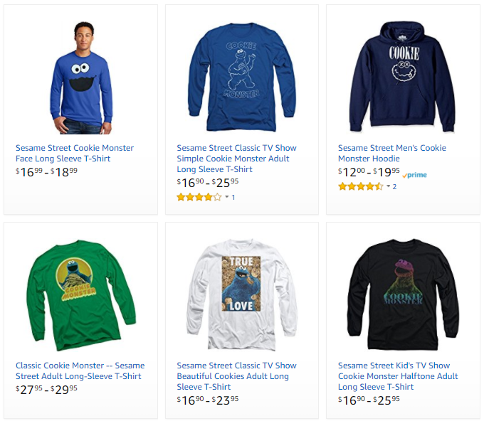
Machine Learning Applications
Problem type
Description
Example
Ranking
Helping users find the most relevant thing
Ranking algorithm within Amazon Search
Recommendation
Giving users the thing they may be most interested in
Classification
Figuring out what kind of thing something is
Regression
Predicting a numerical value of a thing
Clustering
Putting similar things together
Anomaly Detection
Finding uncommon things
Notes:
Let’s also look over some ML applications

Slide 12


Machine Learning Applications
Problem type
Description
Example
Ranking
Helping users find the most relevant thing
Recommendations across the website
Amazon’s Choice
Recommendation
Giving users the thing they may be most interested in
Classification
Figuring out what kind of thing something is
Regression
Predicting a numerical value of a thing
Clustering
Putting similar things together
Anomaly Detection
Finding uncommon things

Slide 13
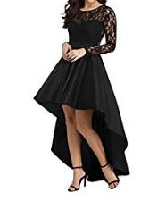
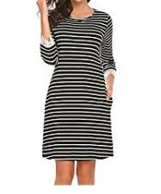
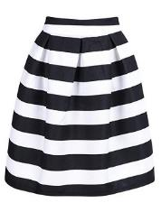
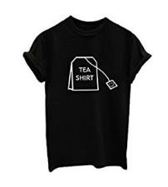
Machine Learning Applications
Problem type
Description
Example
Ranking
Helping users find the most relevant thing
Product classification for our catalog
Recommendation
Giving users the thing they may be most interested in
Classification
Figuring out what kind of thing something is
High-Low Dress
Straight Dress
Regression
Predicting a numerical value of a thing
Clustering
Putting similar things together
Anomaly Detection
Finding uncommon things
Striped Skirt
Graphic Shirt

Slide 14
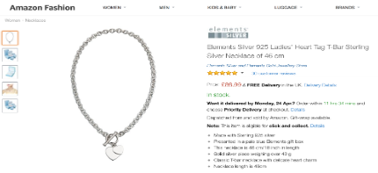
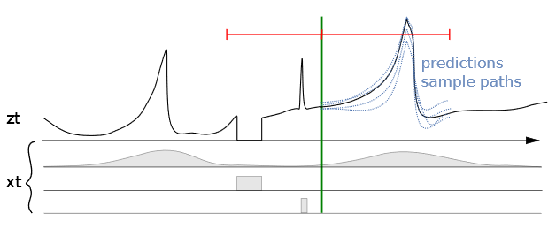
Machine Learning Applications
Problem type
Description
Example
Ranking
Helping users find the most relevant thing
Predicting sales for specific ASINs
Recommendation
Giving users the thing they may be most interested in
Classification
Figuring out what kind of thing something is
Regression
Predicting a numerical value of a thing
Clustering
Putting similar things together
Anomaly Detection
Finding uncommon things
Seasonality | Out of stock | Promotions

Slide 15
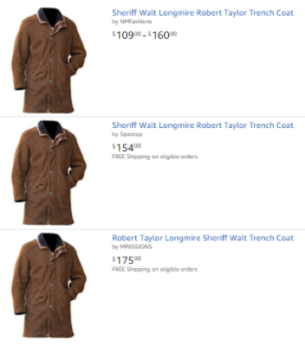
Machine Learning Applications
Problem type
Description
Example
Ranking
Helping users find the most relevant thing
Close-matching for near-duplicates
Recommendation
Giving users the thing they may be most interested in
Classification
Figuring out what kind of thing something is
Regression
Predicting a numerical value of a thing
Clustering
Putting similar things together
Anomaly Detection
Finding uncommon things

Slide 16


Machine Learning Applications
Problem type
Description
Example
Example
Ranking
Helping users find the most relevant thing
Fruit freshness
Recommendation
Giving users the thing they may be most interested in
Before
After
Classification
Figuring out what kind of thing something is
Regression
Predicting a numerical value of a thing
Clustering
Putting similar things together
Good
Damage
Serious Damage
Decay
Anomaly Detection
Finding uncommon things

Slide 17
Supervised vs Unsupervised Learning
Notes:
All looked/worked great with our toy dataset, but real life data – that’s another (long) story
how much data: more data samples, more features
what type of data: numerical, categorical, text (not all numbers ?!)
missing values
different scales (large/small) numerical values
outliers

Slide 18
Supervised vs. Unsupervised Learning
Problem type
Description
Ranking
Helping users find the most relevant thing
Supervised Learning
Data is provided with the correct labels
Recommendation
Giving users the thing they may be most interested in
Classification
Figuring out what kind of thing something is
Regression
Predicting a numerical value of a thing
Unsupervised Learning
Data is provided without labels
Clustering
Putting similar things together
Anomaly Detection
Finding uncommon things
Notes:
As we have touched upon when discussing the ML Lifecycle,
Business P/ML Problem formulation are usually followed by
Data Collection & Data Processing stages
Speaking of data and learning from data, depending on what data we can collect or is provided,
the actual learning would be learning with some labeled data – appropriately called supervised l.
or learning using data without labels, that is unlabeled data – appropriately called unsupervised l.
While there are some gray boundaries when it comes to problem types and learning types,
Classification and Regression are part of SL, while
Clustering is a form of UL.
Ranking, Recommendations and Anomaly Detection are typically supervised, but unsupervised or semi-supervised techniques exist as well.

Slide 19
Supervised vs. Unsupervised Learning
Supervised Learning
Unsupervised Learning
Data is provided with the correct labels
Model learns by looking at these examples
Data is provided without labels
Model finds patterns in data
Regression (Quantity)
Classification (Category)
K-Means
Collaborative Filtering
PCA
Linear
KNN
Neural Net
Trees
SVM
Logistic
Notes:
Another interesting thing about ML is the plethora of ML algorithms to solve the same type of problem.
While certain algorithms tend to perform better than others with certain types of data, no single algorithm outperform all others on all problems.
This concept is called the no free lunch theorem.
And so, for a given task/problem, choose a few algorithms known to work well for the type of data and problem,
and choose the best-performing one
Let’s narrow down initial choices by dividing ML algorithms into categories, based on the task they perform and how they perform it.

Slide 20
Supervised Learning: Regression
Supervised Learning
Data is provided with the correct labels
Model learns by looking at these examples
Price
Regression (Quantity)
Classification (Category)
SqFootage
Label
Features
Price | Bedrooms | SqFootage | Age
280.000 | 3 | 3292 | 14
210.030 | 2 | 2465 | 6
… | … | … | …
Linear
KNN
Neural Net
Trees
SVM
Logistic
Notes:
Very popular SL problem type, regression aims to learn relationships and correlations between input features and a continuous output variable,
with the scope of predicting the continuous output variable.
For example, the price of a house corresponds to a certain combination of no of bedrooms, sqfootage, age and so on.
Shown here, a linear regression model, assuming the relationship between the price and sqFootage is linear, that is a straight line.
- as sqf increases the price of the house increases.
Given historical data, prices of houses with these characteristics on the market,
one can learn such a model that can be later used to predict the sale price of a new given home based on its descriptors.
Some ML algorithms that can be used to build such models, are listed here:

Slide 21
Supervised Learning: Classification
Supervised Learning
Data is provided with the correct labels
Model learns by looking at these examples
Class 1 = star
Class 0 = not star
Feature 2
Regression (Quantity)
Classification (Category)
Feature 1
Label
Features
Star | Points | Edges | Size
1 | 5 | 10< | 750
0 | 0 | >9 | 150
… | … | … | …
Linear
KNN
Neural Net
Trees
SVM
Logistic
Notes:
If you’d rather be interested to know whether the house given its characteristics was sold or not, that would be what’s called classification.
The other very popular SL problem type, classification aims to learn relationships between input features and a output variable,
with the scope of separating the data into classes/groups.
For example, the star or not star classes correspond to a certain combination of no of points, edges and size here…
Shown here, a binary classification scenario, that is we only have two classes.
Some ML algorithms that can be used to build classification models, are …

Slide 22
Unsupervised Learning: Clustering
Unsupervised Learning
Feature 2
Data is provided without labels
Model finds patterns in data
Feature 1
Features
K-Means
Collaborative Filtering
PCA
Age | Music | Books
21 | Classical | Practical Magic
47 | Jazz | The Great Gatsby
… | … | …
Notes:
One example of UL is clustering,
That involves grouping unlabeled data points according to their features/attributes.
For example, clustering can be used in market segmentation;
where we try to find customers that are similar to each other whether in terms of behaviors or attributes,

Slide 23
Unsupervised Learning: Clustering
Unsupervised Learning
Feature 2
Data is provided without labels
Model finds patterns in data
Feature 1
Features
K-Means
Collaborative Filtering
PCA
Age | Music | Books
21 | Classical | Practical Magic
47 | Jazz | The Great Gatsby
… | … | …
Notes:
The most common kind of clustering is K-means clustering,
which involves selecting a number of desired clusters and
partitioning the data into these many clusters
such that data points in each cluster are as similar as possible.

Slide 24
Class Imbalance
Notes:
All looked/worked great with our toy dataset, but real life data – that’s another (long) story
how much data: more data samples, more features
what type of data: numerical, categorical, text (not all numbers ?!)
missing values
different scales (large/small) numerical values
outliers

Slide 25
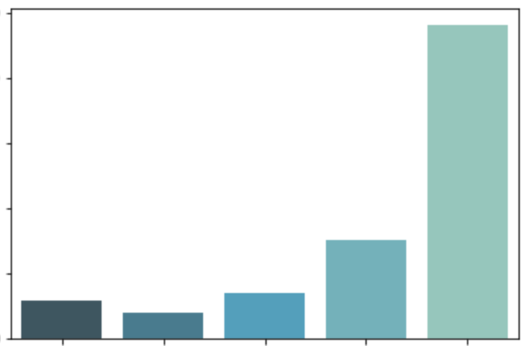
Class Imbalance
Star rating count in millions
Number of samples per class is not equally distributed.
The ML model may not work well for the infrequent classes.
Examples:
Fraud Detection
Anomaly Detection
Medical Diagnosis
2.5
2
1.5
Star rating count
1
0.5
1
2
3
4
5
Star rating
Amazon review dataset: The number of 5 star reviews almost equals the total of the other 4 types of star reviews combined.
Notes:
Number of samples per class is not equally distributed.
The ML model may not work well for the infrequent classes.
Examples:
Fraud Detection
Anomaly Detection
Medical Diagnosis

Slide 26
Class Imbalance
How to address class imbalance problem?
Down-sampling
Up-sampling
Data generation
Sample weights
Reduce the size of the dominant or frequent class(es).
Increase the size of the rare or small class(es).
Create new records, similar but not identical.
For example, create similar images distorting original images by rotating, introducing noise or skewing.
For a model that uses a cost function, assign higher weights to rare class(es) and lower weights to dominant class(es).

Slide 27
Missing Values
Notes:
All looked/worked great with our toy dataset, but real life data – that’s another (long) story
how much data: more data samples, more features
what type of data: numerical, categorical, text (not all numbers ?!)
missing values
different scales (large/small) numerical values
outliers

Slide 28
Handling Missing Values
Drop rows and/or columns with missing values: Remove those rows and/or columns from the dataset.
Less training data samples and/or less features can lead to overfitting/underfitting
Impute (fill-in) the missing values:
Average imputation on missing numerical values: Replace with the average value in the column -
Common point imputation on missing categorical values: Replace with the most common value for that column -
Placeholder: Assign a common value for missing data location
Advanced imputation: Predict missing values from complete samples using ML techniques. For example, AWS Datawig uses neural networks to predict tabular data missing values https://github.com/awslabs/datawig
df[‘col'].fillna((df['col'].mean()))
df['col'].fillna((df['col'].mode()))

Slide 29
SimpleImputer in sklearn
SimpleImputer: sklearn imputation transformer for completing missing values -
SimpleImputer(missing_values=nan, strategy='mean', fill_value=None, verbose=0, copy=True, add_indicator=False)
numerical data:
Strategy = “mean”, replace missing values using the mean along each column
Strategy = “median”, replace missing values using the median along each column
numerical or categorical data:
Strategy = “most_frequent”, replace missing using the most frequent value along each column
Strategy = “constant”, replace missing values with fill_value
.fit(), .transform()

Slide 30
Training – Validation – Test Sets
Original Dataset
Training Set
Training Set
(used to train the model)
Validation Set
(used for unbiased evaluation of the model)
Test Set
Test Set
(used for final evaluation of the model)
Learning
Train, tune and validate the model (multiple times!)
Testing
(Final) Test the model
The test set is not available to the model for learning, it is only used to ensure that the model generalizes well on new “unseen” data.
Notes:
Beyond good choices of evaluation metrics to monitor ML model learning, there’s another key factor to discuss when evaluating models -- the datasets!
Just like with any other learning,
how do we make sure the learned model will be useful beyond training?
You know upfront you want to build a model on some data, to be used on other future similar dataset.
The scope of learning is not to repeat something you’ve seen and learned well, but rather how to generalize what you learned to unseen similar data.
In other words, we’re not ultimately interested in training performance/error, we’re interested in test perf/error (perf/error on new data).
One way to ensure your model learning from some dataset will perform well on other similar dataset is
to explicitly build, train, evaluate and test your model on different datasets!
If you are not being given separate train and test datasets, make sure you split your data upfront, into training and test datasets – that is, set apart the test set to test your model build on the training dataset.
We can then estimate test error by pretending we haven’t seen some of our data.
Even then, model building involves some experimentation/tuning (like say what ML alg parameters to choose - these are traditionally called hyperparameters),
With the test set locked away/Without peeking into the test set,
If you still want to measure performance on unseen data as a way of selecting a good model,
one option is to further divide the training dataset into a training set and a validation set.
You then proceed as before but this time you use the validation set to validate the performance and tweak algorithm’s hyperparameters, selecting the model that performs best on this validation set.
You can train this best model on the full training set (including the validation set), for the last time, and this gives you the final model,
that you can test on the test set to get a final good estimate of the generalization error.

Slide 31
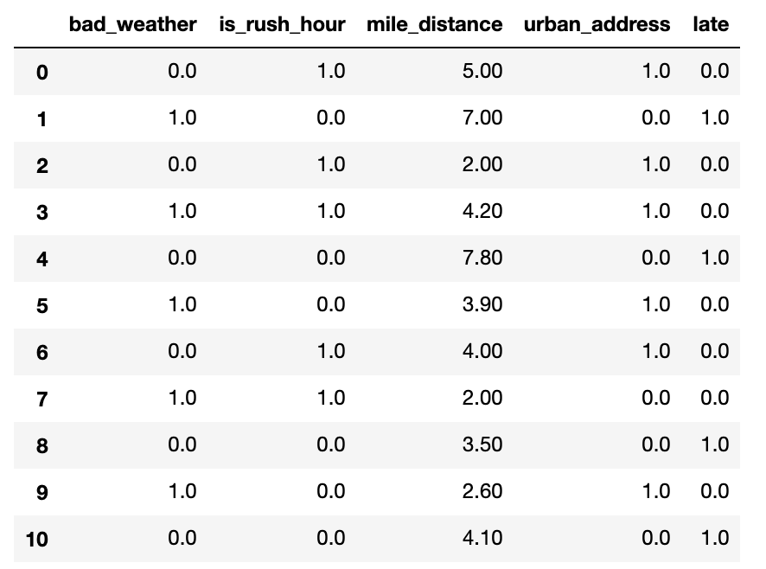
Training – Validation – Test Sets
Original Dataset
Training Set
Training Set
(used to train the model)
Validation Set
(used for unbiased evaluation of the model)
Test Set
Test Set
(used for final evaluation of the model)
Learning
Train, tune and validate the model (multiple times!)
Testing
(Final) Test the model
It is good practice to shuffle the dataset before the split to avoid bias in the resulting sets.
Training Set
Validation Set
Test Set
Notes:
Now that you know what these datasets do, you might be looking for recommendations on how to split your dataset into Train, Validation and Test sets…
You can simply slice your dataset, or use library fcts to split, like the train_test_split from sklearn
It’s also good practice to shuffle the dataset before splitting to avoid bias in the resulting sets.
As for how much of the original dataset should be kept for training and test,
this mainly depends on the total number of samples in your data
Like many other things in machine learning,
the train-test-validation split ratio is quite specific to your case / dataset / algorithm of choice.
Does your choice of alg need more training data to learn?
Does your choice of alg have many hyperparameters to tweak/tune?
Do you have a lot of data to begin with?
Experimenting with different split ratios is the answer, after a while you might get a sense what works best for your particular case.
When we don’t have sufficient data to train/validate your model,
there is another method in town that can help with that …

Slide 32
K-fold Cross Validation ( K = 5)
K-fold Cross-Validation (CV) is a validation technique to see how well a trained model generalizes to an independent validation set.
Use K different holdout samples to validate the model, each time training with the remainder samples:
Split the training dataset into K independent folds.
Repeat the following K times:
Set aside K^{th} fold of the data for validation.
Train the model on the other folds, the training set.
Test the model on the validation set.
Average or combine the model performance metrics.
1st
2nd
3rd
4th
5th
Training
Training
Training
Training
Validation
Training
Training
Training
Validation
Training
Training Set
Validation
Training
Training
Training
Training
Training
Validation
Training
Training
Training
Validation
Training
Training
Training
Training
Average or combine validation performance metrics
Notes:
K-fold CV is a popular validation technique to magically
give you the opportunity to train and validate your choice of model multiple times, say K times,
using the same dataset basically…
Here explained for K = 5
We split the training dataset into 5 independent folds.
And repeat the following 5 times:
Set aside 5th fold of the data for validation.
Train the model on the other folds, the training set.
Test the model on the validation set.
Finally, average or combine the five model performance metrics.
Because K-fold CV is a popular technique to assist with model learning and model tuning
many Machine Learning library functions do this by default!

Slide 33
Model Evaluation: Underfitting
Underfitting: Model is not good enough to describe the relationship between the input data (x₁, x₂) and output y: {Class 1, Class 2}.
Model is too simple to capture important patterns of training data.
Model will perform poorly on training and validation (and/or test).
Class 1
Class 2
x₂
x₁
Notes:
Now, we built a model, we picked a business metric to judge performance of model on the training/validation/test datasets…
What can we learn from examining these metric/scores?
For one, low scores on training, say high regression errors or negative/close to 0 R2, or classification metrics close to 0,
all these, are red flags, telling us that the model didn’t really learn much,
IT IS NOT FIT to do the task is training it for! So It’s UNDERFITTING!
the model did not capture the important patters in the training dataset,
An underfitting model did not perform well on the training,
and is not expected to generalize to new data.
Tweaking model hyperparameters’ could help address overfitting,
Going back to the data processing/feature engineering as discussed over the ML Lifecycle slide is also an option.
Sometimes switching to another ML alg altogether is a better solution!

Slide 34

Model Evaluation: Overfitting
Overfitting: Model memorizes or imitates training data, and fails to generalize well on new “unseen” data (test data).
Model is too complex.
Model picks up the noise instead of the underlying relationship.
Model will perform well on training, but poorly on validation (and/or test).
Class 1
Class 2
x₂
x₁
Notes:
At the other extreme, and more common in ML
is however, when the model works wonders on the training dataset, but fares poorly on the val/test!
How can this be?
The model learns everything is to be learned in the training data, (overdoing it!)
Including every detail and noise in the training data
to the extent that it might negatively impact the performance of the model on future data.
All those details and noise that the model picked from the training data as rules
might not apply to new data,
are not THE generalizable patterns our model was hunting for,
and therefore negatively impact model ability to generalize.
This touches upon the trickiest/most common problem/obstacle in ML: OVERFITIING
Several techniques are available to lessen the chance of, or amount of, overfitting
(reducing the so called generalization gap observed between performance scores on training and validation)
the least we can do it make sure we train and validate our models performance on different datasets!

Slide 35
Model Evaluation: Good Fit
Appropriate fitting: Model captures the general relationship between the input data (x₁, x₂) and output y: {Class 1, Class 2}.
Model not too simple, not too complex.
Model picks up the underlying relationship rather than the noise in the training.
Model will perform good enough on training and validation (and/or test).
Class 1
Class 2
x₂
x₁
Notes:
Ideally, we want to build ML models somewhere in between these two extremes: U and O.
This ideal state is what a good/appropriate fit would be,
- With the understanding that we will have to compromise on models’ performance on the training set,
paying less attention to the noise in the dataset
and concentrate more on the patterns that can be generalized,
that is, can apply with success to future unseen data samples.
This is where the validation set/CV comes in handy,
building models on the training set and validating on the validation sets,
keeping an eye on the performance metrics on validation in particular
aiming for the model that performs good enough on both
Capturing the model that gives us the best validation performance.
Apart from CrossValidation, many other ML techniques and ML algorithms help find such ‘appropriate fit’ models, like
Early stopping - When you’re training an ML model iteratively, you can measure how well each iteration of the model performs. Up until a certain number of iterations, new iterations improve the model. After that point, however, the model’s ability to generalize can weaken as it begins to over fit the training data
Regularization: Regularization refers to a broad range of techniques for artificially forcing your model to be simpler.
Ensembling: Ensembles are machine learning methods for combining predictions from multiple separate models

Slide 36
Model Evaluation
Notes:
Let’s talk about Machine Learning Model Evaluation
How do we know whether the Mach Learning model we built, trained and used to make predictions with, is actually a good model?
How do we evaluate ML models?
What metrics are there to use?
And, what data we (should) use to evaluate models on

Slide 37
Regression Metrics
Metrics | Equations
Mean Squared Error (MSE)
Root Mean Squared Error (RMSE)
Mean Absolute Error (MAE)
R Squared (R²)
: Data values
: Predicted values
: Mean value of data values,
: Number of data records
Notes:
Evaluating REGR models: Let’s first note that all these four regr metrics are looking at the overall model errors, either taking these errors in abs values or squared values (so that the negative errors can contribute in a meaningful way to the overall sum)
What do we mean by errors, are the differences between the y_is = target values (these are the y of our black dots data points here) and y_hats = the values predicted with the regression model (that will be the y’s of the points sitting on the orange regression line)
The first metric, the MSE (short for Mean Sq Error) is the average of the squared errors
As MSE squares the error differences, it penalizes even the smallest errors, leading to over-estimation of how bad the model is.
The next metric, the RMSE short for Root Mean Sq Error is also widely used for regression tasks, simply being the square root of the Mean Sq Error.
While Mean Sq Error reports errors in units squared, the Root Mean Sq Error reports the errors in the original units, making it easier to interpreted the error.
MAE short for…: is the average of the absolute differences between the target values and the values predicted by the model.
Being a linear score, all the individual differences are weighted equally, hence the MAE is more robust to outliers and does not penalize the errors as extremely as MSE.
R² on the other hand is a metric that helps compare our regr model with a constant average baseline model (that is predict averages for all data points), and tells us how much better the regr is vs this baseline model.
While with the other metrics, is desirable to lower the scores, the R2 is different.
Assuming that the ML model will always perform better than the baseline/average model, R² will take values between 0 and 1.
-If the regr model did not improve at all over the baseline model, producing same errors, R2 = 0 (lowest)
-The best regr model, meaning no errors between the predicted values and the actual values (MSE =0), R2 will be 1 (highest)
While the MSE is the most preferred metrics for regression tasks,
just like anything else with ML, there is no clear choice which metric to use.
Best practice is to monitoring a few, depending on the business problem and the dataset.
~~~~~~~~~~~~
LATEX
MSE = \frac{1}{n}\sum_{i=0}^{n}(y^{(i)}-\hat{y}^{(i)})^2
RMS = \sqrt{\frac{1}{n}\sum_{i=0}^{n}(y^{(i)}-\hat{y}^{(i)})^2}
MAE = \frac{1}{n}\sum_{i=0}^{n}|y^{(i)}-\hat{y}^{(i)}|
R^2 = 1 - \frac{\sum_{i=0}^{n}(y^{(i)}-\hat{y}^{(i)})^2}{\sum_{i=0}^{n}(y^{(i)}-\bar{y})^2}
\bar{y} = \frac{1}{n}\sum_{i=0}^{n}y^{(i)}
y^{(i)} \hat{y}^{(i)} \bar{y}

Slide 38
Classification Metrics
Prediction
True Positive: Predicted ‘Positive’
when the actual is ‘Positive’
False Positive: Predicted ‘Positive’
when the actual is ‘Negative’
False Negative: Predicted ‘Negative’
when the actual is ‘Positive’
True Negative: Predicted ‘Negative’
when the actual is ‘Negative’
Positive
Negative
True Positive
False Negative
Positive
18
3
True State
False Positive
True Negative
‘Positive’ = star
‘Negative’ = not star
Negative
1
15
Notes:
How about evaluating classification models?
In the case of the classification models (a binary classification task shown here for simplicity)
the performance of the model and its associated errors can be judged by examining
correctly classified cases vs incorrectly classified cases.
Given our star/not star example, here called positive/negative classes,
we define as TP those data points that were pred P when the
….
We record our classifier results in a so called confusion matrix –
(reflecting the fact that the classifier is sometimes confused and makes mistakes)
For our binary classification problem the matrix has 2 rows and 2 columns.
Across the top are the predicted class labels and down the side are the actual class labels.
Each cell contains the number of predictions made by the classifier that fall into that cell.
The Conf Matrix makes it easier to observe the relations between the classifier outputs, and
Examining the CM usually gives a good idea whether or not the classifier we built is bad or good.
In our case here, we seem to have done at pretty good job at assigning most data points to their correct classes…
A perfect classifier would correctly predict all cases, so high numbers would stay on the main orange diagonal and nothing would fall off this diagonal into the False/error tiles
While the confusion matrix contains all information of the outcomes of a classifier,
is rarely used for reporting results because is difficult to compare and discuss.
Instead, some overall numerical scores extracted from the confusion matrix are commonly used.

Slide 39
Classification Metrics: Accuracy
Prediction
Positive
Negative
Accuracy*: The percent (ratio) of cases classified correctly
True Positive
False Negative
Positive
18
3
True State
False Positive
True Negative
Negative
1
15
Notes:
Building on the intuition that a good classifier would predict most cases correctly, an so its Confusion Matrix would have higher numbers on the main diagonal,
here’s the most popular classification metric, called accuracy:
For our scenario here, accuracy turns out to be 0.89
a pretty good accuracy score…
Closer to 1 the better, with 0 being the worst
Accuracy seems to be easy to compute, easy to interpret and easy to compare across models.
````````````````
Accuracy = \frac{TP+TN}{TP+FP+FN+TN}
Accuracy = \frac{18+15}{18+1+3+15}=0.89
^{*} (bad) \, 0 \leq Accuracy \leq 1 \, (good)

Slide 40
Classification Metrics: Accuracy
Prediction
Positive
Negative
High Accuracy Paradox: Accuracy is misleading when dealing with imbalanced datasets - few True Positives, the ‘rare’ class, and many True Negatives, the ‘dominant’ class. High Accuracy even when few True Positives.
True Positive
False Negative
Positive
2
8
True State
False Positive
True Negative
Negative
2
88
Notes:
However, in a problem where there is a large class imbalance, many true negatives say,
a model can predict/return the value of the majority class for all predictions (without much learning that is)
and still achieve a high classification accuracy,
This is called the High Acc paradox!
Think of a rare disease scenario, where out of a labeled dataset of 100 patients,
10 have the disease, 90 don’t and your classifier was able to correctly identify only 2 people of the all diseased people out there
The accuracy of such classifier would be pretty high, at 0.90
But is this classifier good at the task it was build for – identify diseased people
Is this a good disease pattern-observer classifier?
Safe to say that this model won’t be very useful in the problem domain.
For problems or rather datasets like this, additional metrics can better be suited to evaluate classifier’s performance.
````````````````
Accuracy = \frac{2+88}{2+2+8+88}=0.90

Slide 41
Classification Metrics: Precision
Prediction
Positive
Negative
Precision*: Accuracy of a predicted positive outcome
True Positive
False Negative
Positive
2
8
True State
False Positive
True Negative
Negative
2
88
Notes:
One such metric is Precision, which is basically the acc of the predicted positive outcomes
and as you see ignores the TrueNeg altogether, and centers on the TruePos alone/
Precision can be thought of as a measure of a classifiers exactness.
As expected, the perf of this classifier on the imbalanced dataset is very poor, close to 0 worst and closer to 1 better.
A low precision can also indicate a large number of False Positives
(that will be the subjects identified as having the disease when they are healthy, and brought in for tests/treatments when not needed)
````````````````
Precision = \frac{TP}{TP+FP}
Precision = \frac{2}{2+2}=0.50
^{*} (bad) \, 0 \leq Precision \leq 1 \, (good)

Slide 42
Classification Metrics: Recall
Prediction
Positive
Negative
Recall*: Measures model’s ability to predict a positive outcome
True Positive
False Negative
Positive
2
8
True State
False Positive
True Negative
Negative
2
88
Notes:
Another metric that centers on the TPs, is Recall…
Recall measures model’s ability to predict a positive outcome,
To basically recall more of those cases that are out there positive
Again, as expected, the perf of our particular classifier is very poor, recall close to 0 being worst and closer to 1 the better.
A low recall usually indicates many False Negatives, which is the case here
(that is people that have the disease and never find out, nor being further tested/treated)
````````````````
Recall = \frac{TP}{TP+FN}
Recall = \frac{2}{2+8}=0.20
^{*} (bad) \, 0 \leq Recall \leq 1 \, (good)

Slide 43
Classification Metrics: F1 Score
F1 Score*: A combined metric, the harmonic mean of Precision and Recall.
Recall
F1 Score
Low when one or both of the Precision and Recall are low
High when both Precision and Recall are high
Precision
Notes:
With most imbalanced dataset scenarios, there’s usually a debate over whether your business problems should improve on precision or recall,
That is say, for our rare case scenario,
whether the classifier should do better on, increase
Precision (that will be equivalent to predicting less FalsePos, minimize the number of healthy people brought in for tests/treatments when not needed)
Or should do better, increase
Recall (equivalent to predicting less FalseNeg, reducing the no of people that have the disease and never find out)
To settle the debate, or rather balance these diff business choices,
F1 score is another score/metric that can be used to basically
maintain a balance between the precision and recall of your classifier
As we can see from this heat map of f1 score vs precision and recall values,
F1 is Low when one or both of the Precision and Recall are low
Also, F1 is high when both the Precision and Recall are high
````````````````
F1\,Score = \frac{2*(Precision * Recall)}{Precision+Recall}
0 \leq F1/,Score \leq 1

Slide 44
Introduction to Natural Language Processing (NLP)
Notes:
All looked/worked great with our toy dataset, but real life data – that’s another (long) story
how much data: more data samples, more features
what type of data: numerical, categorical, text (not all numbers ?!)
missing values
different scales (large/small) numerical values
outliers

Slide 45
Some NLP Terms
Corpus: Large collection of words or phrases - can come from different sources: documents, web sources, database
Common Crawl Corpus: web crawl data composed of over 5 billion web pages (541 TB)
Reddit Submission Corpus: publicly available Reddit submissions (42 GB)
Wikipedia XML Data: complete copy of all Wikimedia wikis, in the form of wikitext source and metadata embedded in XML. (500 GB)
Etc.

Slide 46
Some NLP Terms
every
bike
electric
party
salad
early
next
come
work
like
part
sense
always
word
hard
doctor
tool
turn
time
code
me
land
time
smart
home
line
ball
soft
pay
science
piece
none
comedy
term
foot
late
debt
lane
cake
go
dress
sense
sun
phone
cook
balance
cold
call
he
tech
equal
Token: Words or phrases extracted from documents
Feature vector: A numeric array that ML models use for different tasks such as training and prediction

Slide 47
Machine Learning with Text Data
Notes:
All looked/worked great with our toy dataset, but real life data – that’s another (long) story
how much data: more data samples, more features
what type of data: numerical, categorical, text (not all numbers ?!)
missing values
different scales (large/small) numerical values
outliers

Slide 48
Machine Learning with Text Data
ML models need well-defined numerical data.
Text data
Text preprocessing
(Cleaning and formatting)
Vectorization
(Convert to numbers)
Train ML Model using numerical data
Stop words removal,
Stemming, Lemmatization
Bag of Words
K Nearest Neighbors (KNN),
Neural Network, etc.

Slide 49
Text Pre-processing
Notes:
All looked/worked great with our toy dataset, but real life data – that’s another (long) story
how much data: more data samples, more features
what type of data: numerical, categorical, text (not all numbers ?!)
missing values
different scales (large/small) numerical values
outliers

Slide 50
Tokenization
Splits text/document into small parts by white space and punctuation.
Example:
These tokens will be used in the next steps in the pipeline.
Sentence | Tokens
“I don’t like eggs.” | “I”, “do”, “n’t”, “like”, “eggs”, “.”

Slide 51
Stop Words Removal
Stop words: Some words that frequently appear in texts, but they don’t contribute too much to the overall meaning.
Common stop words: “a”, “the”, “so”, “is”, “it”, “at”, “in”, “this”, “there”, “that”, “my”
Example:
Original sentence | Without stop words
“There is a tree near the house” | “tree near house”

Slide 52
Stop Words Removal
Stop words: Some words that frequently appear in texts, but they don’t contribute too much to the overall meaning.
Common stop words: “a”, “the”, “so”, “is”, “it”, “at”, “in”, “this”, “there”, “that”, “my”
Example:
Original sentence | Without stop words
“There is a tree near the house” | “tree near house”

Slide 53
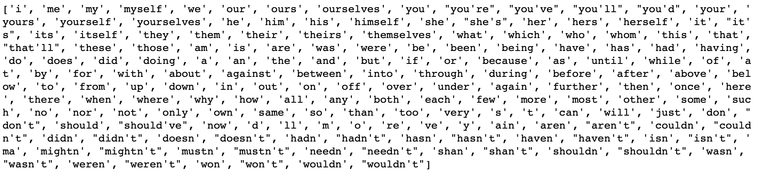
Stop Words Removal
Stop words from the Natural Language Tool Kit (NLTK)* library:
Assume, we have a text classification problem: A product review is positive or negative.
Is this a good stop words list for this problem?
* https://www.nltk.org/

Slide 54
Stop Words Removal
Stop words from the Natural Language Tool Kit (NLTK)* library:
Assume, we have a text classification problem: A product review is positive or negative.
Is this a good stop words list for this problem? NO
* https://www.nltk.org/

Slide 55
Stemming
Set of rules to slice a string to a substring that usually refers to a more general meaning.
The goal is to remove word affixes (particularly suffixes) such as “s”, “es”, “ing”, “ed”, etc.
“playing”
“played” “play”
”plays”
The issue: It doesn’t usually work with irregular forms such as irregular verbs: “taught”, “brought”, etc.

Slide 56
Lemmatization
Similar to stemming, but more advanced. It uses a look-up dictionary.
Handles more situations and usually works better than stemming.
“taught” -”am”
“teaching” “teach” -”is” “be”
“teaches” -“are”
For the best results, correct word position tags should be provided: “adjective”, “noun”, “verb” etc.

Slide 57
Stemming vs. Lemmatization
As we pointed out, lemmatization is a more complex method and usually works better. E.g.,
Original sentence: "the children are playing outside. the weather was better yesterday."
Stemming => “the children are play outside. the weather was better yesterday”
Lemmatization => “the child be play outside. the weather be good yesterday”

Slide 58
Text Processing – Hands-on
In this exercise, we will go over:
Simple text cleaning processes
Stop words removal
Stemming, Lemmatization
MLA-NLP-Lecture1-Text-Process.ipynb

Slide 59
Text Vectorization
Notes:
All looked/worked great with our toy dataset, but real life data – that’s another (long) story
how much data: more data samples, more features
what type of data: numerical, categorical, text (not all numbers ?!)
missing values
different scales (large/small) numerical values
outliers

Slide 60
Bag of Words (BoW)
Bag of Words method converts text data into numbers.
It does this by
Creating a vocabulary from the words in all documents
Calculating the occurrences of words:
binary (present or not)
word counts
frequencies

Slide 61
Bag of Words (BoW)
Simple example using word counts:
 | a | cat | dog | is | it | my | not | old | wolf
“It is a dog.” | 1 | 0 | 1 | 1 | 1 | 0 | 0 | 0 | 0
“my cat is old” | 0 | 1 | 0 | 1 | 0 | 1 | 0 | 1 | 0
“It is not a dog, it a is wolf.” | 2 | 0 | 1 | 2 | 2 | 0 | 1 | 0 | 1

Slide 62
Bag of Words (BoW)
Simple example using word counts:
 | a | cat | dog | is | it | my | not | old | wolf
“It is a dog.” | 1 | 0 | 1 | 1 | 1 | 0 | 0 | 0 | 0
“my cat is old” | 0 | 1 | 0 | 1 | 0 | 1 | 0 | 1 | 0
“It is not a dog, it a is wolf.” | 2 | 0 | 1 | 2 | 2 | 0 | 1 | 0 | 1

Slide 63
Bag of Words (BoW)
Simple example using word counts:
 | a | cat | dog | is | it | my | not | old | wolf
“It is a dog.” | 1 | 0 | 1 | 1 | 1 | 0 | 0 | 0 | 0
“my cat is old” | 0 | 1 | 0 | 1 | 0 | 1 | 0 | 1 | 0
“It is not a dog, it a is wolf.” | 2 | 0 | 1 | 2 | 2 | 0 | 1 | 0 | 1

Slide 64
Bag of Words (BoW)
Simple example using word counts:
 | a | cat | dog | is | it | my | not | old | wolf
“It is a dog.” | 1 | 0 | 1 | 1 | 1 | 0 | 0 | 0 | 0
“my cat is old” | 0 | 1 | 0 | 1 | 0 | 1 | 0 | 1 | 0
“It is not a dog, it a is wolf.” | 2 | 0 | 1 | 2 | 2 | 0 | 1 | 0 | 1

Slide 65
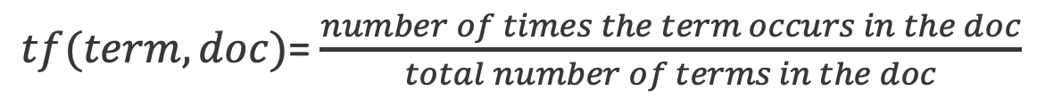
Term Frequency (TF)
Term frequency (TF): Increases the weight for common words in a document.
$tf(term, doc)$= $\frac{number of times the term occurs in the doc}{total number of terms in the doc}$
 | a | cat | dog | is | it | my | not | old | wolf
“It is a dog.” | 0.25 | 0 | 0.25 | 0.25 | 0.25 | 0 | 0 | 0 | 0
“my cat is old” | 0 | 0.25 | 0 | 0.25 | 0 | 0.25 | 0 | 0.25 | 0
“It is not a dog, it a is wolf.” | 0.22 | 0 | 0.11 | 0.22 | 0.22 | 0 | 0.11 | 0 | 0.11

Slide 66
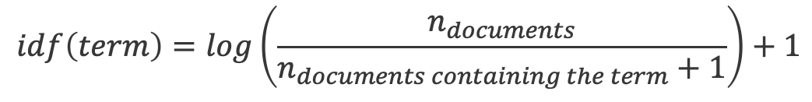
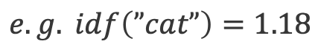
Inverse Document Frequency (IDF)
term | idf
a | log(3/3)+1=1
cat | log(3/2)+1=1.18
dog | log(3/3)+1=1
is | log(3/4)+1=0.87
it | log(3/3)+1=1
my | log(3/2)+1=1.18
not | log(3/2)+1=1.18
old | log(3/2)+1=1.18
wolf | log(3/2)+1=1.18
Inverse document frequency (IDF): Decreases the weights for commonly used words and increases weights for rare words in the vocabulary.
$$idf\left(term\right)=\log\left(\frac{n_{documents}}{n_{documents containing the term}+1}\right)+1$$
$$e.g. idf\left(”cat”\right)=1.18$$

Slide 67
Term Freq.-Inverse Doc. Freq (TF-IDF)
Term Freq. Inverse Doc. Freq (TF-IDF): Combines term frequency and inverse document frequency.
$$tf_{idf}(term,doc)=tf\left(term, doc\right)∗idf(term)$$
 | a | cat | dog | is | it | my | not | old | wolf
“It is a dog.” | 0.25 | 0 | 0.25 | 0.22 | 0.25 | 0 | 0 | 0 | 0
“my cat is old” | 0 | 0.3 | 0 | 0.22 | 0 | 0.3 | 0 | 0.3 | 0
“It is not a dog, it a is wolf.” | 0.22 | 0 | 0.11 | 0.19 | 0.22 | 0 | 0.13 | 0 | 0.13

Slide 68
N-gram
An n-gram is a sequence of n tokens from a given sample of text or speech.
We can include n-grams in our term frequencies too.
Sentence | 1-gram (uni-gram): | 2-gram (bi-gram):
It is not a dog, it is a wolf | “it”, “is”, “not”, “a”, “dog”, “it”, “is”, “a”, “wolf” | “it is”, “is not”, “not a”, “a dog”, “dog it”, “it is”, “is a”, “a wolf”

Slide 69
Bag of Words – Hands-on
In this exercise, we will convert text data to numerical values.
We will go over:
Binary
Word Counts
Term Frequencies
Term Freq.- Inverse Document Freq.
MLA-NLP-Lecture1-BOW.ipynb

Slide 70
K Nearest Neighbors (KNN)
Notes:
Let’s talk about the K Nearest Neighbors Algorithm
Ready to wrap up the day here and ‘put it all together’, building a KNN model on a larger dataset
Let’s first talk about KNN in greater detail..

Slide 71
K Nearest Neighbors (KNN)
K Nearest Neighbors (KNN) predicts new data points based on K similar records from a dataset.
Class
Class
What class does belong to?
Look at the K closest data points:
Choose K = 3
?
?
Notes:
KNN is a Supervised L algorithm, that can be used for both REGR and CLASSIFICATION problems,
That predicts new data points based on K similar records from a dataset.
Let’s see how this works in practice for a binary classification problem,
To classify a new data point, here represented by the ?
Given some data samples characterized by two features x1 an x2
Of two classes, the blue and the orange class.
As mentioned, with KNN we are looking at the nearest neighbors of this data point to infer its class label.
Let’s try K = 3

Slide 72
K Nearest Neighbors (KNN)
K Nearest Neighbors (KNN) predicts new data points based on K similar records from a dataset.
Class
Class
What class does belong to?
Look at the K closest data points:
Choose K = 3
Calculate the distances from to all data points
?
?
?
Notes:
Calculate the distance from ? To all data points in the data sample
for simplicity we assume
that the features are real-valued
And we use Euclidean distance

Slide 73
K Nearest Neighbors (KNN)
K Nearest Neighbors (KNN) predicts new data points based on K similar records from a dataset.
Class
Class
What class does belong to?
Look at the K closest data points:
Choose K = 3
Calculate the distances from to all data points
Find the K nearest neighbors
?
?
?
Notes:
We sort the list of all distances, and grab the top 3, in our case these three here with the back circles around them…

Slide 74
K Nearest Neighbors (KNN)
K Nearest Neighbors (KNN) predicts new data points based on K similar records from a dataset.
Class
Class
What class does belong to?
Look at the K closest data points:
Choose K = 3
Calculate the distances from to all data points
Find the K nearest neighbors
Pick the majority class:
?
?
?
Notes:
voting for labels,
from the nearest three, looks like our new data sample should be labeled as orange!
Very easy to understand the KNN working mechanism
And also very easy to use hands-on and practice …

Slide 75
KNN in sklearn
KNeighborsClassifier: sklearn classifier implementing the K Nearest Neighbors vote -
KNeighborsClassifier(n_neighbors=5, metric='minkowski’, p=2)
n_neighbors: How to choose K?
metric: How to calculate distances?
The full interface is larger.
.fit(), .predict()
Notes:
With sklearn’s implementation of KNN alg from the neighbors module
note KNN’s parameters such as the n_neighbors and the distance metric…
With the default choice for the n_neigbors being 5
and the default choice for the metric being M metric with p=2, which is no other than the classic Euclidean metric
How important are these choices of (hyper)parameters?

Slide 76
KNN: Choosing K
How to choose K?
Use a validation set to select an appropriate value for K.
K = 1, =
K = 3, =
K = 5, =
K = 7, =
?
?
?
?
?
?
?
?
Notes:
The number of neighbors(K) in KNN is a hyperparameter that you need to choose at the time of model building.
Different choices of K might lead to different class predictions, as we see here,
and you will have to find what value of K works best for your dataset,
by using a validation set.
That is, train different KNN models with different K values on a training dataset
and validate them on the validation set,
picking the K value that gives best validation performance.

Slide 77
KNN: Choosing K
What is the effect of K on the model?
Low K (like K=1): predictions based on only one data sample could be greatly impacted by noise in the data (outliers, mislabeling)
Large K: more robust to noise, but the nearest “neighborhood” can get too inclusive, breaking the “locality”, and a class with only a few samples in it will always be outvoted by the other classes
Rule of thumb in selecting K:
K = , where is the number of data samples
Notes:
Even so, you’d have to start with some values of K,
so let’s add some comments here:
*In the case of a small number of neighbors (like the extreme case of K=1),
the noise in the data will have a higher influence on the result, to think of outliers and/or mislabeled data points
leading to more irregular decision boundary (like the overfitting models)
*as K increases/a large number of neighbors, there is a larger sample around our ?, the prediction will have a higher statistical confidence
making the model/decision boundary, while more robust to noise, very smooth
simpler, less complex and less performant (like the underfitting model)
Thinking of the other extreme, K = the size of the dataset, where predictions would be same for every new data point, basically the majority vote.
A good Rule of thumb, for choosing the L value would be a value definitely lower than the training size, somewhere around sqrt(that size)
With that being said thought, KNN seems to be most successful handling classification problems where each class has many possible prototypes, and the decision boundary is usually quite irregular!

Slide 78
KNN: Choosing the Distance Metric
Data samples are considered similar to each other if there are close to each other, as determined by a specific distance metric.
How to choose the distance metric?
Real-valued features:
Similar types: p = 2, Euclidean
Mixed types (lengths, ages, salaries): p = 1, Manhattan (taxi-cab)
Binary-valued features: Hamming
number of positions where the values of two vectors are different
Boolean-valued features: Jaccard
ratio of shared values to the total number of values of two vectors
High dimensional feature space: cosine similarity
the angle between two vectors (similarity irrespective of their sizes)
Notes:
Let’s now have a look at distance metrics choices
Finding closest/similar points, means finding the distance between points using distance measures such as:
the default minkowski with p=2 equivalent to the Euclidean distance,
Which Is well suited to handle real-values vector spaces, in particular num values of similar types (len, height)
Whereas mink + p=1 - Manhattan (taxi-cab) – is better suited for real-valued features of mixed type (age, length, salaries, etc)
Depending on other characteristics of the model features, like categorical features, other distance measures may be more appropriate, like
metric choices intended for binary/integer-valued and boolean-valued vector spaces (Hamming, Jaccard, cosine similarity, to name a few)
Hamming = given two binary valued vectors = returns the number of positions where the value patterns are different
Jaccard = given two Boolean valued vectors = returns the number of shared values divided by the total number of values in both vectors
High dim dataset, Euclidean distance is not useful - other measures such as cosine similarity are preferred, which are less affected by high dimension the angle between two vectors (similarity irrespective of their sizes)

Slide 79
KNN: Curse of Dimensionality
With too many features, KNN becomes computationally expensive and difficult to solve.
Data closeness
Data sparsity
?
?
?
Notes:
Speaking of high dimensional feature space
With too many features, KNN becomes computationally expensive and difficult to solve.
Computationally expensive: both in finding the neighbors, and storing the entire training data for example.
While there are some fast algs for finding NN, which can reduce the comp load somewhat
the BIGGER Issue is that KNN breaks down when the dimensionality of the feature space is high…
Why?
IN GENERAL: In a high-dim space, most points taken from a random finite set
inside a finite volume are far away from each other!
As someone once said “a high-dimensional space is a lonely place.”
What we mean by this is that, not only are the points increasingly far from the mean on average,
they are also increasingly far from each other.
If you think of two points that are one unit away from each other in each direction/each dimension
on a line, that is 1D
moving in 2D, the points are actually sqrt(2) apart
In 3D, are sqrt(3) apart, and so on
the distance between them grows as N grows, to be ‾‾√N
Another way of looking at this is that in higher dimensions, the points on average
become further and further away from the center of a hypersphere,
They also become further and further away from each other .
So as the dimension grows the points appear further from each other,
with more and more volume filling up the space between them.
For KNN specifically: The “curse of dimensionality” refers to
the problem of classifying and organizing high dimensional data.
In short: The more features we have, more data points we need in order to fill space.
As the data space seen above moves from one dimension to
two dimensions and finally to three dimensions, the given data fills
less and less of the data space. In order to maintain an accurate representation of the space,
the data for analysis will need to also grow exponentially. In low dimensional spaces, data may seem very similar but
the higher the dimension the further these data points may seem to be.
In 3D, we can see that the points are now more apart (sparse) in this new higher dimension space(3D).
As a result, finding the neighbors becomes harder
We can imagine that as we add more dimensions the data become more and more apart. (In other words, we need more and more data if you want to avoid having sparsity in our data)
---------------------
Let's say you have a straight line 100 yards long and you dropped a penny somewhere on it. It wouldn't be too hard to find. You walk along the line and it takes two minutes.
Now let's say you have a square 100 yards on each side and you dropped a penny somewhere on it. It would be pretty hard, like searching across two football fields stuck together. It could take days.
Now a cube 100 yards across. That's like searching a 30-story building the size of a football stadium.
The difficulty of searching through the space gets a *lot* harder as you have more dimensions.

Slide 80
KNN: Feature Scaling
Features should be on the same scale when using KNN.
Unscaled features: closer to
Scaled features: closer to
?
?
10
(K = 1)
1
( almost halved)
5
?
0.5
?
d2 = 2
d2 = 0.2
3
0.3
0
80 85
0
1
100
0.80 0.85
d1 = 5
( changed less)
d1 = 0.05
Notes:
Typically with KNN we also first scale the numerical features, since it’s possible that they are measured in different units.
This unit difference causes Distance-Based algorithms such as KNN to not perform optimally,
so it is necessary to rescale features that have different units to have same scale/units.
Let’s examine a KNN model (here K=1 for simplicity) in an unscaled vs . scaled situation:
Considering here two features with two quite diff units: x1 could be age (1-100 years) and x2 could be
height (1-10 ft).
Examining the unscaled features scenario, while trying to identify that one nearest neighbor needed for class assignment for our new data point, looks like the blue dot is closer.
However when we compute the distance between the new data point and the blue point, that distance (5) turns out to be much more than the distance from the new data point to the orange datapoint (2),
and therefore the orange data point wins so to speak, and the class prediction for our new data point is orange.
Somehow this doesn’t quite make sense when taking into account the diff in scale/units of the two features considered.
For example the distance between the ndp and the blue point, of 5, is more like a 5% change (small change) in the great scheme of things along x1;
whereas the distance from our ndp to the orange dot, of 2, is more of a deal from the x2 perspective, like a 20% change!
According to this observation, the ndp would be much closer (less change) to the blue dot, instead!
This is exactly how things look in the scaled scenario, where bringing both x1 and x2 on the same units make d1=0.05 and d2=0.2, and therefore the class prediction for the ndp is blue.

Slide 81
Feature Scaling
Motivation: Many algorithms are sensitive to features being on different scales, like metric-based algorithms (KNN, K Means) and gradient descent-based algorithms (regression, neural networks)
Note: tree-based algorithms (decision trees, random forests) do not have this issue
Solution: Bring features to the same scale
Common choices (both linear):
Mean/variance standardization
MinMax scaling
Notes:
Motivation: Many algorithms are sensitive to features being on different scales, like metric-based algorithms (KNN, K Means) and gradient descent-based algorithms (regression, neural networks)
Note: tree-based algorithms (decision trees, random forests) do not have this issue
Solution: Bring features to the same scale
Common choices (both linear):
Mean/variance standardization
MinMax scaling

Slide 82
Standardization in sklearn
StandardScaler: sklearn scaler, scaling values to be centered around mean 0 with standard deviation 1 -
.fit(), .transform()
Transform:
from sklearn.preprocessing import StandardScaler
stdsc = StandardScaler()
raw_data = np.array([[-3.4], [4.5], [50], [24], [3.4], [1.6]])
scaled_data = stdsc.fit_transform(raw_data)
print(scaled_data.reshape(1,-1))
Notes:
StandardScaler:
sklearn scaler, scaling values to be centered around mean 0 with standard deviation 1 -
Let’s see it in action here on a short array :
from sklearn.preprocessing import StandardScaler
stdsc = StandardScaler()
raw_data = np.array([[-3.4], [4.5], [50], [24], [3.4], [1.6]])
scaled_data = stdsc.fit_transform(raw_data)
print(scaled_data.reshape(1,-1))
-0.9. -0.47 1.98 0.57 -0.53 -0.63

Slide 83
MinMax Scaling in sklearn
MinMaxScaler: sklearn scaler, scaling values so that minimum value is 0 and maximum value is 1 -
.fit(), .transform()
Transform:
from sklearn.preprocessing import MinMaxScaler
minmaxsc = MinMaxScaler()
raw_data = np.array([[-3.4], [4.5], [50], [24], [3.4], [1.6]])
scaled_data = minmaxsc.fit_transform(raw_data)
print(scaled_data.reshape(1,-1))
Notes:
MinMaxScaler: sklearn scaler, scaling values so that minimum value is 0 and maximum value is 1 -
Let’s see it in action here on a short array :
from sklearn.preprocessing import StandardScaler
stdsc = StandardScaler()
raw_data = np.array([[-3.4], [4.5], [50], [24], [3.4], [1.6]])
scaled_data = stdsc.fit_transform(raw_data)
print(scaled_data.reshape(1,-1))
0 0.14 1 0.51 1.12 0.09

Slide 84
KNN – Hands-on
Exercise: Training a classifier to predict the isPositive field for the review dataset:
The exercise covers the following topics:
Training-validation-test split
Text processing and Bag of Words feature extraction
ML Model: K Nearest Neighbors (KNN) Regressor
MLA-NLP-Lecture1-KNN.ipynb

